Slide 1

SWE Service Implementations

Slide 2
Overview
What is available?
52° North SWE Implementations
  52° North
  Services
    Sensor Observation Service (SOS)
    Sensor Alert Service (SAS)
    Sensor Planning Service (SPS)
    Web Notification Service (WNS)

Slide 3
52° North SOS
Access to sensor data and metadata
OGC CITE compliant to the 1.0.0 SOS specification
Supported operations
  Core profile
  Transactional profile
In development: Support for mobile sensors

Slide 4
52° North SOS
  Database support
  Built-In PostGIS support
  ORACLE
  DAO-Concepts facilitates the integration of further database implementations
In addition: Special SOS version for video data
  Allows access to video data
  Live streams
  Video sequences of past time periods

Slide 5
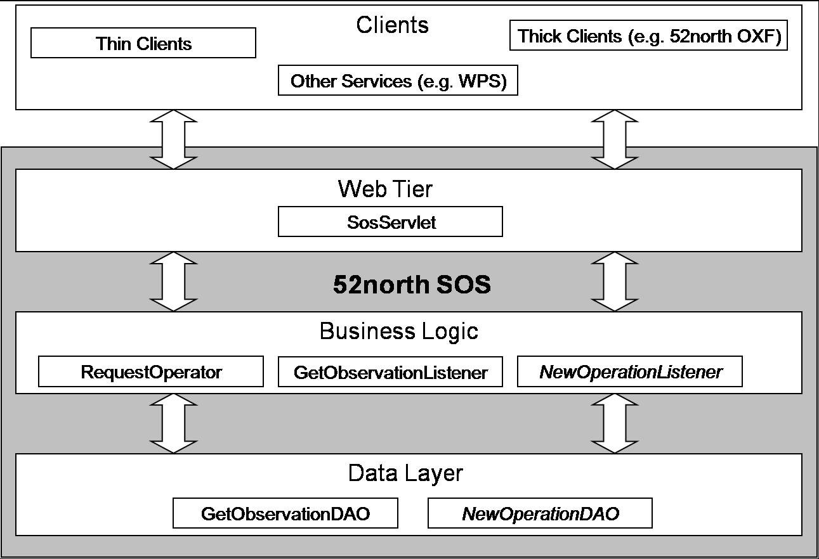
52° North SOS

Slide 6
52° North SAS
Subscription to user defined alert conditions
Compliant to OGC SAS specification 0.9.0 RFC
Features
  Dispatch alerts via XMPP (extensible messaging and presence protocol)
  Support of other communication protocols through gateway services like WNS

Slide 7
52° North SES
New version
  Under development
  Based on ongoing discussions within the OGC SWE WG
  Will make use of the Sensor Event Service (SES) ideas
    Complex Event Processing
    Conjunctions between alert criteria
    Inclusion of spatial, temporal and more comprehensive thematic filtering criteria

Slide 8
52° North SPS
Tasking of sensors and simulation models
OGC CITE compliant to the 1.0.0 SPS specification
Implement the full SPS standard
Features
  Modular plug-in architecture allows the easy integration of new sensor types
  Exemplary plug-in available for Axis network camera

Slide 9
52° North WNS
Supporting asynchronous communication processes between services and clients
Based on OGC best practice paper (OGC 06-095)
Features
  SMTP (E-Mail) notification support
  XMPP notification support
  SMS notification support
  Fax notification support
  Phone notification support

Slide 10
Thank you for your attention!

